Slide 1
Regression & Logistic Regression

Slide 2
Agenda
Start | End | Item
 |  | Regression in Action
 |  | Partitioning Data
 |  | Understanding Regression (simple univariate)
 |  | Build & Evaluate a Multiple Linear Regression
 |  | Logistic Regression for Classification
 |  | KPI Review
 |  | Review
 |  | Customer Survey Case
NA | NA | Appendix – LM variable selection

Slide 3
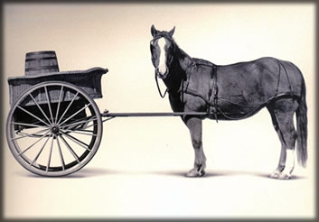
Let’s Practice
Open A_Regression.R
Predict Diamond Prices with linear regression.

Slide 4


Slide 5
Agenda
Start | End | Item
 |  | Regression in Action
 |  | Partitioning Data
 |  | Understanding Regression (simple univariate)
 |  | Build & Evaluate a Multiple Linear Regression
 |  | Logistic Regression for Classification
 |  | KPI Review
 |  | Review
 |  | Customer Survey Case
NA | NA | Appendix – LM variable selection

Slide 6
The Problem of Overfitting
Statistical models can produce highly complex explanations of relationships between variables
The “fit” may be excellent
When used with new data, models of great complexity do not do so well.
Notes:
6

Slide 7
100% fit – not useful for new data
Notes:
7

Slide 8
Overfitting, continued.
Causes:
Too many predictors
A model with too many parameters
Trying many different models
Lack of data knowledge & problem understanding
Consequence: Deployed model will not work as well as expected with completely new data.

Slide 9
Minimize Overfitting - Partitioning
Divide data into training portion and validation portion
Test model on the validation portion
Training Data
All Data
Test Data
Notes:
How do you want to “spend” data

Slide 10
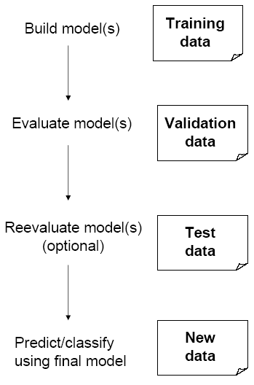
Data Partitioning – Training & Test
Problem: How well will our model perform with new data?
Solution: Separate data into at least two parts
Training partition to develop the model
Validation partition to implement the model and evaluate its performance on “new” data
The validation set is the closest to real world model performance since it is “unseen” by the model training process. Therefore partitioning addresses the issue of overfitting

Slide 11
Minimize Overfitting - Partitioning
Divide data into training portion , validation & test portions
Test model on the validation portion
Training Data
All Data
Validation
Data
Test Data
Notes:
How do you want to “spend” data

Slide 12
Data Partition – Training/Validation/Test
When a model is developed on training data, it can overfit the training data (hence need to assess on validation)
Assessing multiple models on same validation data can overfit validation data
Some methods use the validation data to choose a parameter. This too can lead to overfitting the validation data
Solution: final selected model is applied to a test partition to give unbiased estimate of its performance on new data

Slide 13
Best Practice
If you have enough data and the impact is large, this is a good partitioning schema
However, this much effort is seldom undertaken.
Feature Engineering
Data
Training Data
All Data
Validation Data
Test Data
Notes:
How do you want to “spend” data
For large data – production, 10% improvement = $500M; 10% overfitting = $-500m
Additional layer of partitionoing CV discussed later

Slide 14

Next Glass
Next Glass is not out of business but leveraged chemistry & modeling for it’s business model.

Slide 15
Let’s Practice
Open B_anotherGlass.R
Engineering/Train/
Validation/Test
Train/Test
Train/Validation/Test

Slide 16
Review
Data Mining consists of supervised methods (Classification & Prediction) and unsupervised methods (Association Rules, Data Reduction, Data Exploration & Visualization)
Before algorithms can be applied, data must be explored and pre-processed
To evaluate performance and to avoid overfitting, data partitioning is used
Models are fit to the training partition and assessed on the validation and test partitions
Today’s lesson explores partitioning and simple prediction and binary classification.

Slide 17
Agenda
Start | End | Item
 |  | Regression in Action
 |  | Partitioning Data
 |  | Understanding Regression (simple univariate)
 |  | Build & Evaluate a Multiple Linear Regression
 |  | Logistic Regression for Classification
 |  | KPI Review
 |  | Review
 |  | Customer Survey Case
NA | NA | Appendix – LM variable selection

Slide 18
Supervised Learning
Goal: Predict a single “target” or “outcome” variable
Training data, where target value is known
Score to data where value is not known
Methods: Classification and Prediction

Slide 19


Supervised Learning
Inferring a function from labeled data.
“Learn from telling”, “Look at my data and I will tell you what to predict”
Business Context
Data Setup
Algorithm
Application
Marketing-Will a customer buy yes or no? How much will a customer spend?
Operations- Will an applicant default? When will a machine break?
Sports Analytics- How many points will the Bears’ QB score? What is the Bears’ probability of winning?
Requires expertise and stakeholder buy in
Flat “Excel” file. Each row is a record or observation. Each column is an attribute of the record.
One column is the outcome, y or target attribute.
Modeling e.g. K-NN, linear regression, decision tree, random forest etc.
Use the model to make predictions for the target label on the new data.

Slide 20

Supervised Learning Example
Inferring a function from labeled data.
“Learn from telling”, “Look at my data and I will tell you what to predict”
What impacts ice cream sales?
#
=ƒ(…)
Notes:
Just did carat to diamond prices
Now let’s add more than 1 input

Slide 21
Linear Regression for continuous outcomes
#
= $β$ + $β$*temperature + $β$*day + $β$*price + error
Some linear combination of temperature values, day of the week dummy variables and price estimate the number of cones that will sell.
Notes:
What should we expect the beta signs to be? Whats the relationship the information has with ice cream sales?
Temp goes up? Sales go up. Temp goes down? Sales go down. Positive relationship
Price goes up? Sales go down. Price goes down? Sales go up. Negative relationship

Slide 22
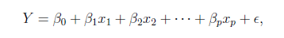
The linear combination equation captures information
outcome
coefficients
constant
error (noise)
predictors

Slide 23
The linear combination equation captures information
Outcome:
The “dependent”, “y” or “target”.
Number of Ice Cream Cones

Slide 24
The linear combination equation captures information
Constant:
The “intercept” or “beta-naught” has no predictor associated with it.
Avg. Number of Ice Cream Cones expected to sell if predictors were all 0.

Slide 25
The linear combination equation captures information
error (noise)
Predictors:
The “informative features”, “x” or “independent” variables.
Variables affecting sales in the data, temp, day, & price.

Slide 26
The linear combination equation captures information
Coefficients:
The “weight”, “betas” or “coefficients” multiplied with the specific “x” variable value.

Slide 27
The linear combination equation captures information
Error:
The “error” or “noise” represents the value the equation is wrong compared to the actual Y.

Slide 28
The linear combination equation captures information
outcome
coefficients
constant
error (noise)
predictors
The combinations of beta coefficients seeks to minimize the squared errors between the actual Y values and the equation. This combination manifests as the “best fit line”

Slide 29
#
= $6$ + 0.$25$*temperature + $3$*satudray_dummy + -0.5*price
Beta-Naught | Temperature | Satuday_dummy | Price
6 | 0.25 * 80 degrees | 3 * 1 | -0.5 * 5
5 | 0.25 * 88 | 3 * 0 | -0.5 * 2

Slide 30
#
= $6$ + 0.$25$*temperature + $3$*satudray_dummy + -0.5*price
Best Fit Prediction | Beta-Naught | Temperature | Satuday_dummy | Price
26.5 | 6 | 20 | 3 | -2.5
27 | 6 | 22 | 0 | -1

Slide 31
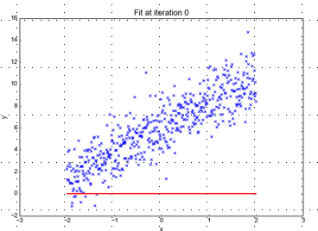
Minimizing the Sum of Ordinary Least Squared Errors
Equation:
Y= 0 +(0*x)
Beta “Naught” = 0
Intercept is 0
X beta coefficient = 0
No slope
Blue points Y Values represent actual outcome.
MINUS
Red line is the predicted outcome
Equals the Error

Slide 32
Big Errors
Equation:
Y= 0 +(0*x)
Beta “Naught” = 0
Intercept is 0
X beta coefficient = 0
No slope
Blue points Y Values represent actual outcome.
MINUS
Red line is the predicted outcome
Equals the Error

Slide 33
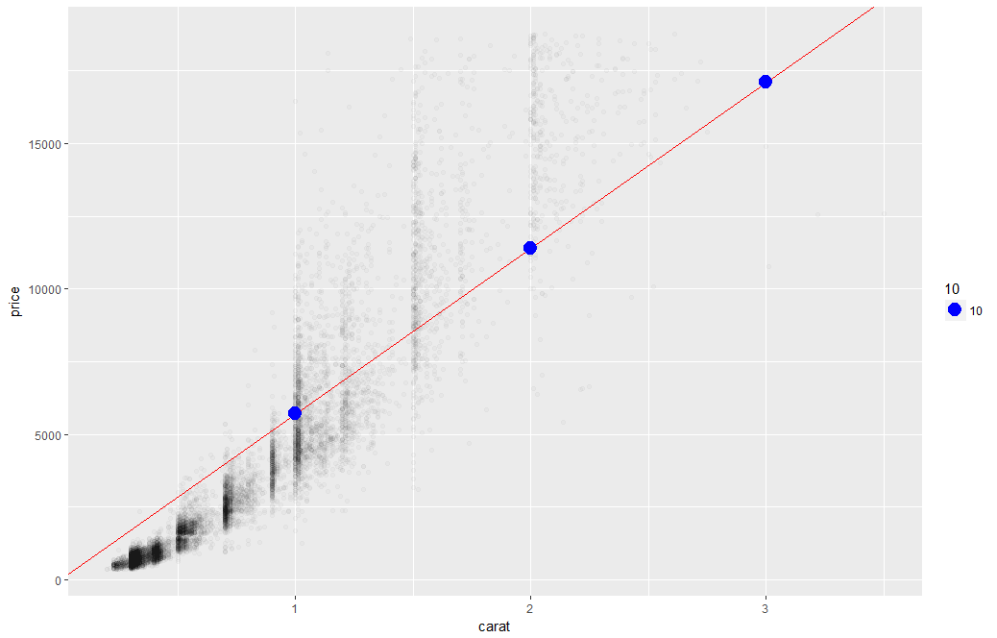
What’s really going on?
Errors between a prediction and actual.
Notice some are negative and some are positive

Slide 34
Why Squared Error?
Blue points Y Values represent actual outcome.
MINUS
Red line is the predicted outcome
Equals the Error
Cones
85
48
45
27
32
30
69
80
15
61
Prediction
67
42
54
95
1
48
51
95
20
22
Error
18
6
-9
-68
31
-18
18
-15
-5
39
-3
(18 + 6 + -9 + -68 + 31 + -18 + 18 + -15 + -5 + 39)
Notes:
Is this a good model?
18 + -18 cancel each other out

Slide 35
Why Squared Error?
Without squaring the errors positive & negative prediction errors cancel each other out.
(18² + 6² + -9² + -68² + 31² + -18² + 18² + -15² + -5² + 39²)
8445
324 + 36 + 81+ 4624 + 961 + 324 + 324 + 225 + 25 + 1521
Squaring the error means all errors have the same impact on the optimization function.
Notes:
Is this a good model?
18 + -18 cancel each other out

Slide 36
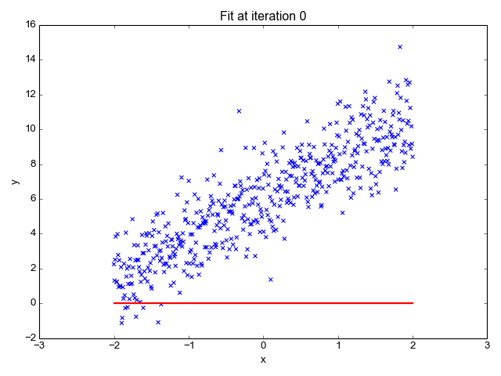
So what is really going on?
The algorithm is optimizing the inputs and weights (beta’s) to minimize the sum of squared errors.
This is called “ordinary least squares (OLS).

Slide 37
Let’s Practice
Open C_Regression_v1.R

Slide 38
Now it’s your turn.
Save As: C_Regression_v1.R to “YourName_Regression_v1.R”
Pick a new variable to review e.g CRIM (crime) or AGE
Plot the new variable relationship with training data
Create a univariate regression with training data and the new variable.
Have no intercept and also an intercept (+0 in the equation)
Plot the regression lines
What is the relationship (review coefficient)? Is it positive or negative?
Apply your two models to the test set
Calculate the sum of ordinary least squares on the test set

Slide 39
Topics
Explanatory vs. predictive modeling with regression
Example: prices of Toyota Corollas
Fitting a predictive model
Assessing predictive accuracy
Selecting a subset of predictors

Slide 40

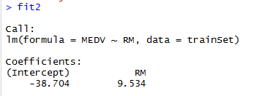
Explanatory Vs Predictive
Reviewing beta coefficients can explain relationships
There is a positive relationship between number of rooms and housing prices.
Holding all other inputs constant the median price would increase 9.534 for each room.
Notes:
Fancy way of saying reviewing identical houses but with 1 bedroom and 2.

Slide 41
Explanatory Modeling
Goal: Explain relationship between predictors (explanatory variables) and target
Familiar use of regression in data analysis
Model Goal: Fit the data well and understand the contribution of explanatory variables to the model
“goodness-of-fit”: R², residual analysis, p-values

Slide 42
Predictive Modeling
Goal: predict target values in other data where we have predictor values, but not target values
Classic data mining context
Model Goal: Optimize predictive accuracy
Train model on training data
Assess performance on validation (hold-out) data
Explaining role of predictors is not primary purpose (but useful)

Slide 43

Explanatory Vs Predictive Modeling
Make sure you understand the point of your project
(explanatory or predictive)
Do leaders want to understand a phenomena?
Do leaders want to build an application?
This impacts how you evaluate the model and even what variables you choose.

Slide 44
Agenda
Start | End | Item
 |  | Regression in Action
 |  | Partitioning Data
 |  | Understanding Regression (simple univariate)
 |  | Build & Evaluate a Multiple Linear Regression
 |  | Logistic Regression for Classification
 |  | KPI Review
 |  | Review
 |  | Customer Survey Case
NA | NA | Appendix – LM variable selection

Slide 45
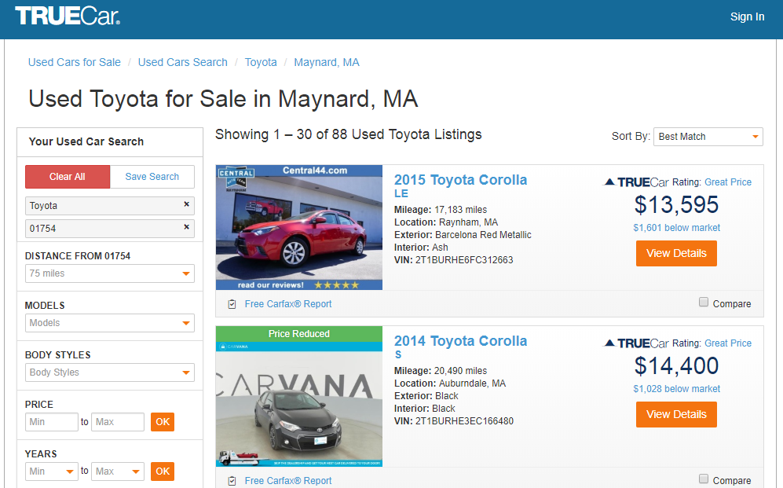
How does truecar.com know the price is “great?”

Slide 46

Yeah! I got a new job!

Slide 47

Welcome Dale to TrueCar’s Competitor: OldCar
Dale, can you predict used car prices? Then we will know if a car is priced above/below expected value

Slide 48

Let’s help Dale again.
But of course. This sounds like a predictive modeling project.

Slide 49
Remember the Workflow?
Problem Definition
Identify Available Data Sources
EDA
Perform Analyssis
Assessment
Communicate Results
Document
Problem Formulation >> Predict Toyota Prices.
Define data requirements >> Use ~1400 cars & car attributes
Explore the data >> in script
Perform Analysis & Create Project Artifacts >> fit a linear regression
Asses/Adjust the Project Artifacts >> Adj. R-Squared, P-Values etc.
Communicate Results >> examine the coefficients and readout Adj R^2
Document to make it repeatable >> Keep notes in script

Slide 50
Let’s practice.
Open D_oldCar.R
Price in Euros
Tires binary 0/1 are new tires on car
Age in months as of 8/04
KM (kilometers)
Fuel Type (diesel, petrol, CNG)
HP (horsepower)
Metallic color (1=yes, 0=no)
Automatic transmission (1=yes, 0=no)
CC (cylinder volume)
Doors
Quarterly_Tax (road tax)
Weight (in kg)
Using the preprocessing and partitioning code in your toolbox, create a linear model of Toyota prices.

Slide 51

Regression is susceptible to multi-colinearity
Math
The presence of two or more predictor variables sharing the same linear relationship with the outcome variable.
Don’t shock the cat by having multi-collinearity.
In other words
Two+ informative features are measuring essentially the same thing.
Example
When predicting ice cream sales you include Fahrenheit and Celsius temperatures as two separate informative features.

Slide 52

Regression is susceptible to multi-colinearity
What happens with multi-collinearity?
The effect is exaggerated e.g. double counted.
The good news
The problem is so prevalent/impactful that R’s linear regression function handles it.
Other algorithms are not affected by double counting
Best Practice
Even though R removes it, do not rely on the function. Understanding the data you put in will avoid “garbage in, garbage out” scenarios.
Make happy cats by
knowing your data.

Slide 53
Back to R, script D!

Slide 54
Agenda
Start | End | Item
 |  | Regression in Action
 |  | Partitioning Data
 |  | Understanding Regression (simple univariate)
 |  | Build & Evaluate a Multiple Linear Regression
 |  | Logistic Regression for Classification
 |  | KPI Review
 |  | Review
 |  | Customer Survey Case
NA | NA | Appendix – LM variable selection

Slide 55
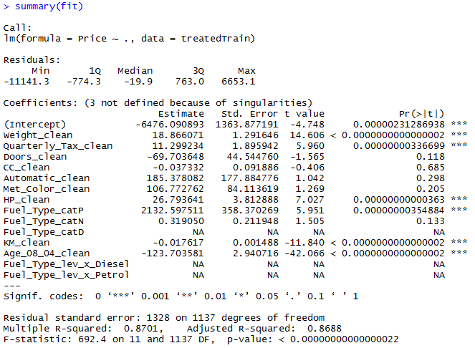
The Summary of the Fit

Slide 56
The Summary of the Fit
Auto ID of multi colinearity

Slide 57
The Summary of the Fit
Another name for errors.
Summary stats for the errors.

Slide 58
The Summary of the Fit
Treated Variable Names i.e. informative features

Slide 59
The Summary of the Fit
Coefficients or Beta values

Slide 60
The Summary of the Fit
The average amount that the coefficients vary from the actual average value of our response variable.
Notes:
We’d ideally want a lower number relative to its coefficients. In other words, the lower the better since it measures how much we can trust the coefficient relationship. If the std error is more than the coefficient you can’t really trust the coefficient since it could be positive or negative…the model couldn’t figure it out.

Slide 61
The Summary of the Fit
The coefficient t-value is a measure of how many standard deviations our coefficient estimate is far away from 0. In another way, values away from 0 indicate a real relationship
Notes:
T-VALUE We want it to be far away from zero as this would indicate we could reject the null hypothesis - that is, we could declare a relationship between weight and price exist. According to T, We are less confident about cylinder displacement (cc) and price’s relationship. The signal of price isn’t really in the variable “cc” and is likely captured in weight and hp.

Slide 62
The Summary of the Fit
P-Values
The probability of seeing a value larger than the t value.
Small p-values mean its less likely due to chance.

Slide 63
The Summary of the Fit
P-Values
In stats p <0.05 is good but in business I have seen p<0.2.
It’s a good idea to rebuild a model without variables that do not meet the cutoff.

Slide 64
The Summary of the Fit
P-Values
We could drop tax, doors, cylcinder displacement (cc), HP to start.
What variables should we drop with a p-value >=0.2?
Notes:
After slide back to script
CC_clean
Automatic_clean
Met_Color_clean
Fuel_Type_catP (prevalence) ie. 42% of the time that level appeared. X_catP =.42 for all level A observations.
GO BACK TO SCRIPT ~LINE60

Slide 65
Back to the script D

Slide 66
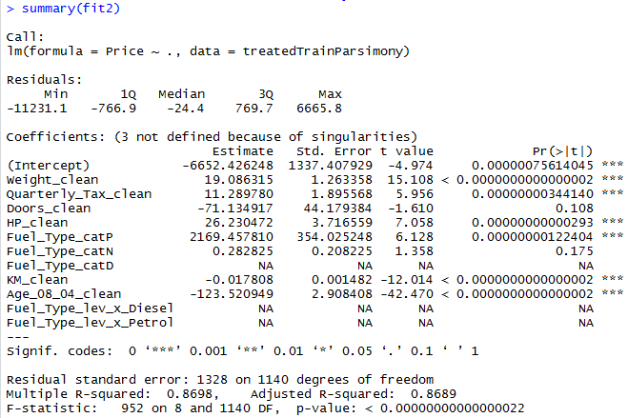
Parsimonious Model
Parsimony or compactness is desirable in models. The more features in a model, the more complexity we introduce, data integrity, data interactions, time to score and time to predict are all impacted.
Notes:
We could drop yet another engineered variable but let’s continue. P =.175

Slide 67
Parsimonious Model
R-Sq: how much of the variation are the model is fitting. R-Sq measures the linear relationship between Price & features It always lies between 0 and 1
Notes:
We could drop yet another engineered variable but let’s continue.

Slide 68
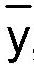
Calculating the R-Squared
1.
Y Values minus Average of all Y Values ( called y-bar)
The average of all actual values is “y-bar” i.e.
R1 Actual Distance = Row 1 Price – Average of all Prices
…
Rn Actual Distance = Row n Price – Average of all Prices
2.
Square the distances to mean calculations
Once again squaring removes the “cancelling” of positive & negative differences.
(R1 Actual Distance )²
…
(Rn Actual Distance )²

Slide 69

Calculating the R-Squared
3.
Y Predictions (y-hat) - Average of all Y Values (y-bar)
R1 Prediction Distance = (Row 1 Prediction – Average of all Prices)
…
Row n Prediction Distance = (Row N Prediction – Average of all Prices)
4.
Square the distances to mean calculation
Another name for predictions from linear regression is “y-hat”
i.e.
(R1 Prediction Distance )²
…
(Rn Prediction Distance )²

Slide 70
Calculating the R-Squared
5.
Sum all the squared PRICE distances
(Row 1 Price – Average of all Prices)² + … + (Row N Price – Average of all Prices)²
6.
Sum all the squared PREDICTION distances
(Row 1 Prediction– Average of all Prices)² + … + (Row N Prediction– Average of all Prices)²

Slide 71
Calculating the R-Squared
7.
#6 Divided by #5 will create R- Squared
R²
6.
Sum all the squared Prediction distances
5.
Sum all the squared Price distances
R-Squared values are 0 to 1. They will always go up as you add more variables so a penalty is introduced to create “adjusted R-squared”
Notes:
It’s a ratio of the variation in predictions to variation in actual vaslues

Slide 72
R-Sq in Action
Step1
Step2
Step3
Step4
ActualPrice | Predictions(y-hat) | ActualMeanPrice(y-bar) | y-(y-bar) | (y-(y-bar))^2 | (y-hat) - (y-bar) | ((y-hat) - (y-bar))^2
8950 | 6919 | 8574 | (8950-6918.631) | 141251 | -1656 | 2740798
7950 | 8185 | 8574 | -624 | (-624.166)^2 | -389 | 151283
8495 | 9377 | 8574 | -79 | 6267 | (9377-8574) | 643933
11950 | 11143 | 8574 | 3376 | 11396251 | 2569 | (11143-8574)^2
6650 | 7728 | 8574 | -1924 | 3702417 | -847 | 716640
7450 | 7231 | 8574 | -1124 | 1263751 | -1343 | 1804441
(y-(y-bar))^2 |  | ((y-hat) - (y-bar))^2
141251 |  | 2740798
389583 |  | 151283
6267 |  | 643933
11396251 |  | 6599761
3702417 |  | 716640
1263751 |  | 1804441
16,899,520 |  | 12,656,855
Step
5 & 6
SUM
Step 7
12656855 | = | 0.77
16,509,937

Slide 73
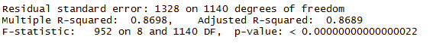
Compare the two models
fit1
fit2
It can be said that both models explain ~87% of the variation in car prices. Dropping the variables improved accuracy and reinforces the fact that the variables didn’t add value.

Slide 74
Evaluating a Prediction Model
RMSE- Root Mean Squared Error
MAPE- Mean Absolute Percentage Error
y
y-hat
Actual Values | Predicted/Forecasted
10 | 6
12 | 8
20 | 18
36 | 20
Besides P-Values which is a variable level KPI, and adjusted R-Sq there are two popular KPI for evaluating continuous model predictions.

Slide 75
RMSE
RMSE- Root Mean Squared Error
Actual Values | Predicted/Forecasted | Errors | Squared Errors
10 | 16 | -6 | 36
12 | 8 | 4 | 16
20 | 17 | 3 | 9
36 | 34 | 2 | 4
Mean
36+16+9+4
4
To manually calculate RMSE, work the acronym backwards.

Slide 76
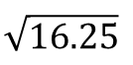
RMSE
RMSE- Root Mean Squared Error
Actual Values | Predicted/Forecasted | Errors | Squared Errors
10 | 16 | -6 | 36
12 | 8 | 4 | 16
20 | 17 | 3 | 9
36 | 34 | 2 | 4
Mean
Square Root
36+16+9+4
$$\sqrt{16.25}$$
4
=4.03
In the same units being measured, tells you +/- the prediction error.

Slide 77
MAPE
MAPE- Mean Absolute Percentage Error
Actual Values | Predicted/Forecasted | Errors | Absolute | As % of Forecast
10 | 16 | -6 | 6 | =6/16 or 37%
12 | 8 | 4 | 4 | =4/8 or 50%
20 | 17 | 3 | 3 | =3/17 or 17%
36 | 34 | 2 | 2 | =2/34 or 5%
Mean of Percentages
37%+50%+17%+5%
4
=27.7%
Instead of squaring error, take the absolute error. Then divide that by the actual value. Lastly calculate a mean average of all the percentage errors.

Slide 78

Back to script D
How good is Dale’s model?
Notes:
For the predict warning about rank deficient matrices:
Rank of the matrix is reduced since it throws out multi-collinear variables. Often can be safely ignored.

Slide 79
Agenda
Start | End | Item
 |  | Regression in Action
 |  | Partitioning Data
 |  | Understanding Regression (simple univariate)
 |  | Build & Evaluate a Multiple Linear Regression
 |  | Logistic Regression for Classification
 |  | KPI Review
 |  | Review
 |  | Customer Survey Case
NA | NA | Appendix – LM variable selection

Slide 80
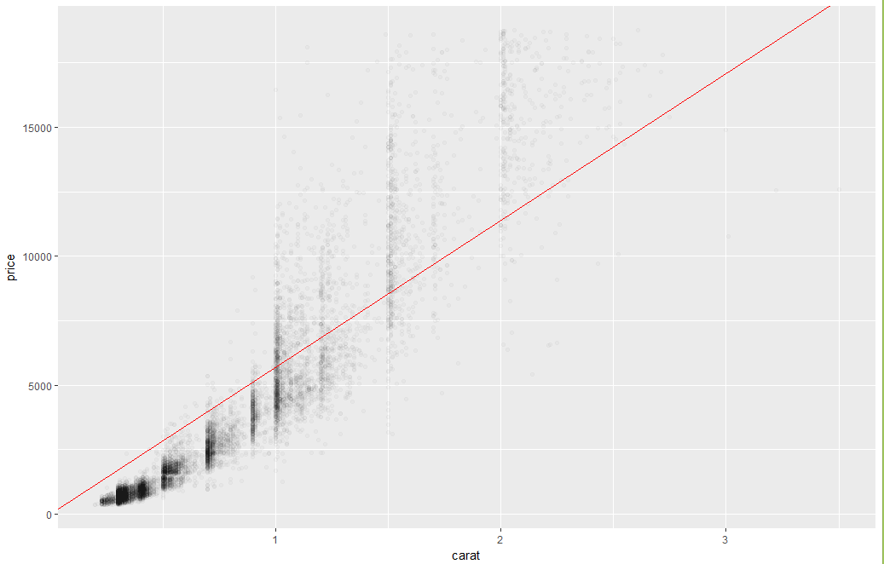
Regression Vs Logistic Regression
Notes:
How does this answer a Y/N question?
Can anyone recognize a problem applying regression to a binary classification?

Slide 81
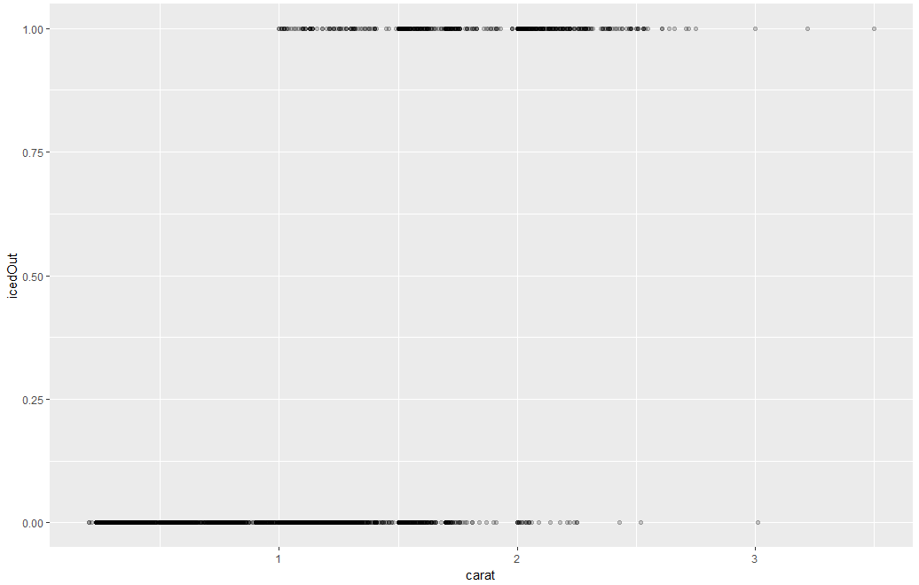
Binary (Price >$11K = 1)

Slide 82
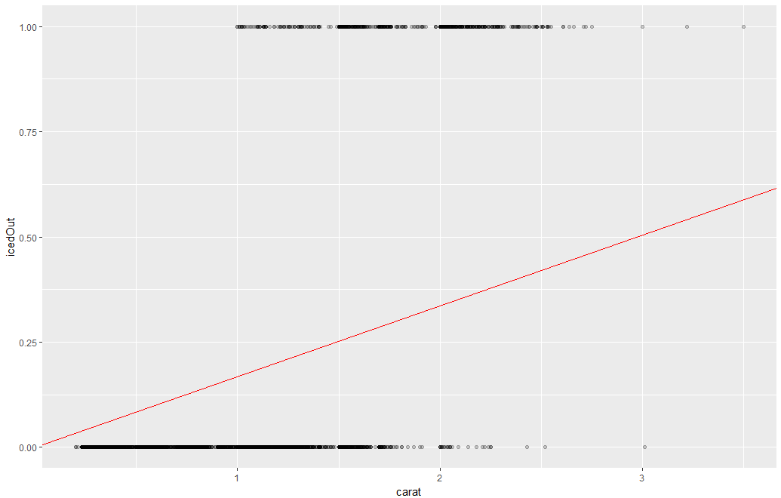
Huh?

Slide 83
Let’s find out firsthand.
Open E_lm_for classes.R

Slide 84
Logistic Regression
Extends idea of linear regression to situation where outcome variable is categorical
Widely used, particularly where a structured model is useful to explain (=profiling) or to predict
Instead of ordinary least squares, β εστιματεσ are derived through an iterative process called maximum likelihood estimation
We focus on binary classification
i.e. Y=0 or Y=1

Slide 85
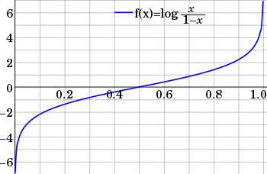
The Logit
Goal: Find a function of the predictor variables that relates them to a 0/1 outcome
Instead of Y as outcome variable (like in linear regression), we use a function of Y called the logit
Logit can be modeled as a linear function of the predictors
The logit can be mapped back to a probability, which, in turn, can be mapped to a class
This is a continuous outcome but has little change as it approaches -1 & 1.

Slide 86
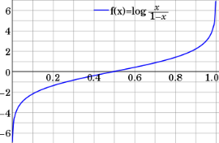
Step 1: Logistic Response Function
p = probability of belonging to class 1
Need to relate p to predictors with a function that guarantees 0 ≤ p ≤ 1
Regression
#
= $β$ + $β$*temperature + $β$*day + $β$*price + error
Logistic Regression
Logit of
= $β$ + $β$*temperature + $β$*day + $β$*price + error

Slide 87
The outcome is logits
= $β$ + $β$*temperature + $β$*day + $β$*price + error
Since the outcome now links to a math function (logit) with a hard to interpret output, the output needs to be adjusted to get something meaningful.

Slide 88
Calculating Probability from Logits
The Fix: use logistic response function
Equation 10.2 in textbook
$$e=natual logarithm \sim 2.718$$

Slide 89
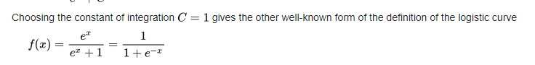
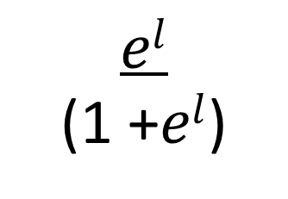
Oh math…
$$I prefer to use a different equation$$
From Wikipedia.com
$$el$$
(1 +$el$)
$$l=the output of the equation (logOdds)$$
$$e=natual logarithm \sim 2.718$$

Slide 90
Calculating the Odds of an Event
The odds of an event are defined as:
eq. 10.3
p = probability of event
Or, given the odds of an event, the probability of the event can be computed by:
eq. 10.4

Slide 91

NCAA Classification Madness
College Basketball
Annual 64 team tournament
Business Impact:
$1B wagered
$2B in lost productivity
Bragging Rights
Objective: Identify the probability of a team winning in Round 1.

Slide 92

My friend Mandy is next level.
https://fivethirtyeight.com/features/how-a-data-scientist-whod-never-heard-of-basketball-mastered-march-madness/

Slide 93
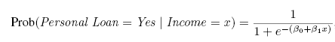
Single Predictor Model
Modeling loan acceptance on income (x)
Fitted coefficients (more later): b₀ = -6.3525, b₁ = -0.0392

Slide 94
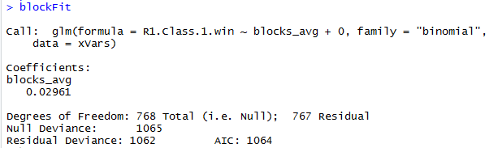
Single Predictor Model
The coefficient is .02961 but this represents the logOdds so you can say for every .029 avg blocks increases the probability by a specific amount. In the following script the output of this blocks_avg * .02961 is equal to “l”

Slide 95
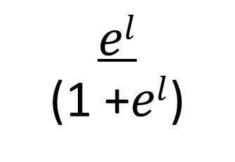
Single Predictor Model
If blocks_avg = 2
0.592
$$el$$
(1 +$el$)
2.718 ^{0.592}
P(Round1 Win = 1 | bocks_avg)
1 + 2.718 ^{0.592}
The probability of a round 1 in given the avg blocks per game is 0.514

Slide 96
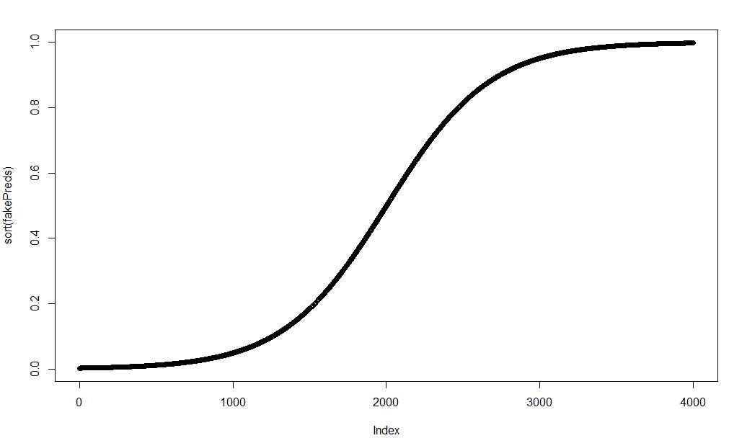
Probabilities approach 0 and 1
Sorted probabilities for avg blocks across a wide spectrum -100 to 100 create an infinite curve of probabilities.

Slide 97
Probabilities to Actual Class Predictions
Model produces an estimated probability of being a “1”
Convert to a classification by establishing cutoff level
If estimated prob. > cutoff, classify as “1”
If a team has a probability of .25 classify them as a loser.
If a team has .50 or more classify them as a winner

Slide 98
With Probability, define a cutoff threshold.
0.50 is popular initial choice
Additional considerations (see Chapter 5)
Maximize classification accuracy
Maximize sensitivity (subject to min. level of specificity)
Minimize false positives (subject to max. false negative rate)
Minimize expected cost of misclassification (need to specify costs)

Slide 99
Variable Selection
Multi-collinearity is still an issue as in linear regression
The number of correlated predictors can grow when we create derived variables such as interaction terms (e.g. Income x Family), to capture more complex relationships
Problem: Overly complex models have the danger of overfitting
Solution: Reduce variables via automated selection of variable subsets (as with linear regression)
See Chapter 6 or the appendix slides

Slide 100
P-values for Predictors
Test null hypothesis that coefficient = 0
Useful for review to determine whether to include variable in model
Important in profiling tasks, but less important in predictive classification

Slide 101
Let’s practice
Open G_fullyMarchMadness.R

Slide 102
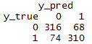
Evaluating a Classification
Confusion Matrix
The model predicted losers 390 (316 + 74) times
The model was correct 316 times for losers
The model predicted 378 winners (68+310)
The model was correct 310 times for winners

Slide 103
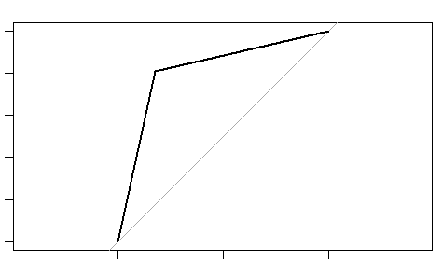
ROC/AUC
True positive rate = positive classification divided by all real positive classifications
False positive rate = positive classification divided by all real negative classifications
True Positive Rate
False Positive Rate

Slide 104
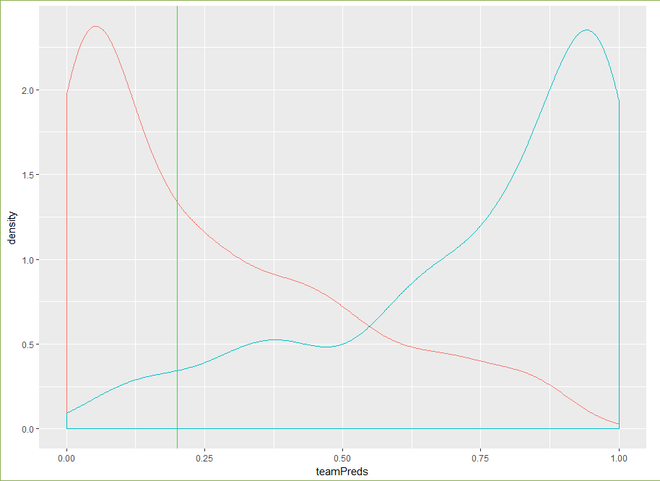
Adjusting the cutoff probability
You can adjust to any probability cutoff between 0 and 1.
When its 0 you are classifying all records as winners.
When its 1 you are classifying all records as losers.
If you had 100 basketball teams (50 winners/50losers) each with 0.01 probability in sequence.
Cuffoff = 0; anything greater than 0 is a “winner”
TPR = 50 /50 =1
FPR = 50/50 =1
Cutoff = 1; everything is a “loser”
TPR = 0/50 = 0
FPR = 0/50 = 0

Slide 105
ROC/AUC
True positive rate = positive classification divided by all real positive classifications
False positive rate = positive classification divided by all real negative classifications
The ROC shows the relationship between TPR & FPR for all possible values between 0/1
The diagonal line represents flipping a coin since it splits the area into two halves. If the curve is above it the model is demonstrating “lift”
The area under the ROC curve (AUC) is a measure of how well a parameter can distinguish between two groups (i.e. winning/losing)
True Positive Rate
False Positive Rate

Slide 106
Logistic Regression Summary
Logistic regression is similar to linear regression, except that it is used with a categorical response
It can be used for explanatory tasks (=profiling) or predictive tasks (=classification)
The predictors are related to the response Y via a nonlinear function called the logit
As in linear regression, reducing predictors can be done via variable selection
Logistic regression can be generalized to more than two classes

Slide 107
Agenda
Start | End | Item
 |  | Regression in Action
 |  | Partitioning Data
 |  | Understanding Regression (simple univariate)
 |  | Build & Evaluate a Multiple Linear Regression
 |  | Logistic Regression for Classification
 |  | KPI Review
 |  | Review
 |  | Customer Survey Case
NA | NA | Appendix – LM variable selection

Slide 108
Continuous Outcome KPI
Error = actual – predicted
ME = Mean error
RMSE = Root-mean-squared error
MAE = Mean absolute error
MPE = Mean percentage error
MAPE = Mean absolute percentage error

Slide 109
Ranking KPI
Normalized Gini coefficient (Gini Norm) and Area Under the Curve (AUC) are the most commonly used
AUC is only for classification and AUC = ( Gini Norm + 1 ) / 2
People like them as they are easy to interpret:
Gini Norm = 1 or AUC = 1 => perfect model
Gini Norm = 0 or AUC = 0.5 => random guess
Main drawback is that they don’t evaluate quality of absolute predictions but only their order. For regression pbs, Gini Norm is also sensitive to outliers

Slide 110
Accuracy KPI
LogLoss (or Binomial deviance) used for classification (lower is better)
Root Mean Square Error (RMSE) typically used for “normal” response
Poisson Deviance typically used for count data
Gamma Deviance typically used for skewed positive response
Tweedie Deviance typically used for zero-inflated skewed positive response (rare events modeling, lots of 0’s)
Mean Absolute Deviance (MAD) typically used in presence of outliers.

Slide 111
How are KPIs used?
Evaluating the fit of a model
Hyper-parameter tuning (will introduce in next lesson)
Some algorithms use KPI to iteratively re-learn the data as a “loss” function

Slide 112
3 Categories of Model KPI
accuracy metrics
measures deviation of predictions from actual value
ranking metrics:
measures the ability to rank patterns from lowest to highest risk/outcome.
business metrics:
takes into account some business aspects
example: conversion rate for top 10% of accounts

Slide 113
Agenda
Start | End | Item
 |  | Regression in Action
 |  | Partitioning Data
 |  | Understanding Regression (simple univariate)
 |  | Build & Evaluate a Multiple Linear Regression
 |  | Logistic Regression for Classification
 |  | KPI Review
 |  | Review
 |  | Customer Survey Case
NA | NA | Appendix – LM variable selection

Slide 114
Linear Regression Summary
Linear regression models are very popular tools, not only for explanatory modeling, but also for prediction
A good predictive model has high predictive accuracy (to a useful practical level)
Predictive models are fit to training data, and predictive accuracy is evaluated on a separate validation data set
Removing redundant predictors is key to achieving predictive accuracy and robustness
Subset selection methods help find “good” candidate models. These should then be run and assessed.

Slide 115
Logistic Regression Summary
Logistic regression is similar to linear regression, except that it is used with a categorical response
It can be used for explanatory tasks (=profiling) or predictive tasks (=classification)
The predictors are related to the response Y via a nonlinear function called the logit
As in linear regression, reducing predictors can be done via variable selection
Logistic regression can be generalized to more than two classes

Slide 116


Your Data Mining Toolbox
Previous Lessons
Some R Programming
Knowledge of Data Preparation
Exploratory Data Analysis
Basic Visualization
After today
You can answer Yes/No Business Questions
You can predict continuous business outcomes
Regression & Logistic Regression are two good starting algorithms . Both put you on a path to more complex machine learning but more importantly you can start to frame business problems in terms algorithms can understand.

Slide 117
Agenda
Start | End | Item
 |  | Regression in Action
 |  | Partitioning Data
 |  | Understanding Regression (simple univariate)
 |  | Build & Evaluate a Multiple Linear Regression
 |  | Logistic Regression for Classification
 |  | KPI Review
 |  | Review
 |  | Customer Survey Case
NA | NA | Appendix – LM variable selection

Slide 118
Customer Satisfaction Survey Case
Scenario:
You run the service analytics department for a large internet retailer. Customer service managers have asked you to examine customer experience. Thus you pulled 10k contacts oversampling the response (survey Y/N) and among these contacts you pulled the customer satisfaction surveys.
Build an explanatory logistic regression with the call attributes. What impacts whether or not a customer fills out the survey?
Build a logistic regression and examine the “sum of betas” to interpret and recommend specific actions the managers should take to coach their agents.

Slide 119
Agenda
Start | End | Item
 |  | Regression in Action
 |  | Partitioning Data
 |  | Understanding Regression (simple univariate)
 |  | Build & Evaluate a Multiple Linear Regression
 |  | Logistic Regression for Classification
 |  | KPI Review
 |  | Review
 |  | Customer Survey Case
NA | NA | Appendix – LM variable selection

Slide 120
Appendix
These slides were not included in the lecture but are helpful reference.

Slide 121
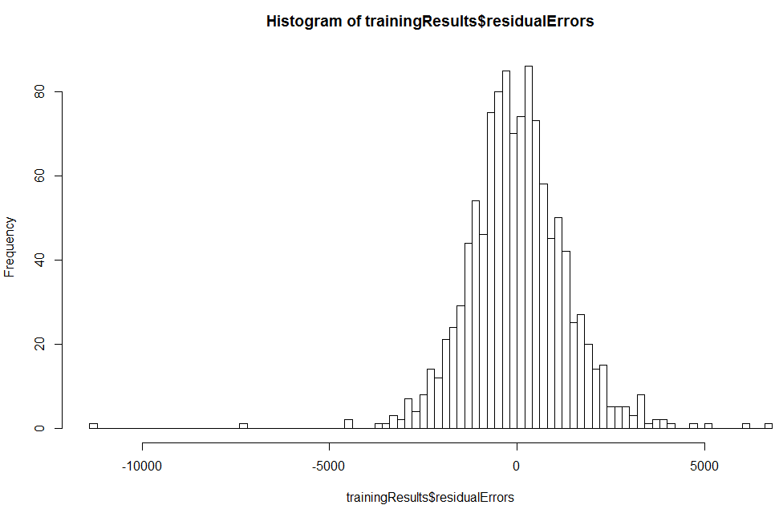
Distribution of Residuals
Homoscedasticity
Linear regression assumes the distribution of errors is normal.
Symmetric distribution
In practice a few outliers is ok.
If there is a trend then you could probably find more variables to account for the systemic missing information.

Slide 122
Variable Selection
Goal: Find parsimonious model (the simplest model that performs sufficiently well)
More robust
Higher predictive accuracy
We will assess predictive accuracy on validation data
Exhaustive Search = “best subset”
Partial Search Algorithms
Forward
Backward
Stepwise

Slide 123
Exhaustive Search
All possible subsets of predictors assessed (single, pairs, triplets, etc.)
Computationally intensive, not feasible for big data
Judge by “adjusted R²”
Use regsubsets() in package leaps
Penalty for number of predictors

Slide 124
Exhaustive Search continued
Exhaustive search requires library leaps and manual coding into binary dummies
library(leaps)
Fuel_Type <- as.data.frame(model.matrix(~ 0 + Fuel_Type, data=train.df))
train.df <- cbind(train.df[,-4], Fuel_Type[,])
head(train.df)
search <- regsubsets(Price ~ ., data = train.df, nbest = 1, nvmax = dim(train.df)[2], method = “exhaustive”)
sum <- summary(search)
sum$which
sum$rsq
sum$adjr2
sum$Cp
show models
show metrics

Slide 125
Forward Selection
Start with no predictors
Add them one by one (add the one with largest contribution)
Stop when the addition is not statistically significant
use step() to run stepwise regression (available in lm).
set direction = forward

Slide 126
Backward Selection
Start with all predictors
Successively eliminate least useful predictors one by one
Stop when all remaining predictors have statistically significant contribution
use step() to run stepwise regression (available in lm).
set direction = backward

Slide 127
Stepwise Selection
Like Forward Selection
Except at each step, also consider dropping non-significant predictors
use step() to run stepwise regression (available in lm).
set direction = both

Slide 128
Throw the kitchen sink at LM!
# Dat
cars <- read.csv('oldCar.csv')
# Partitioning 20% test set
splitPercent <- round(nrow(cars) %*% .8)
set.seed(2017)
idx <- sample(1:nrow(cars), splitPercent)
trainSet <- cars[idx, ]
testSet <- cars[-idx, ]
#PreProcessing
dataPlan <- designTreatmentsN(cars, names(cars)[2:13], 'Price')
treatedTrain <- prepare(dataPlan, trainSet)
treatedTest <- prepare(dataPlan, testSet)
# Fit
fit <- lm(Price ~ ., treatedTrain)
# Step
backFit <- step(fit,direction = 'backward')
summary(backFit)

Slide 129
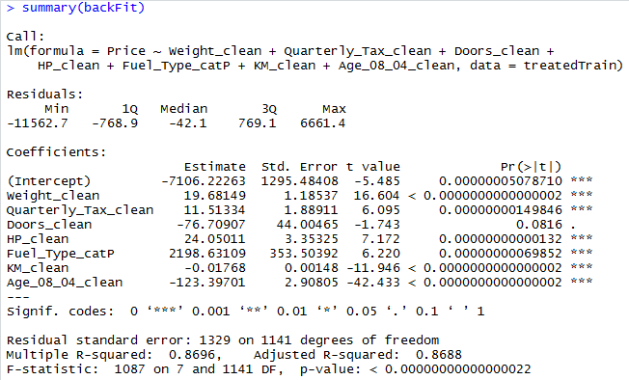
Dropped an additional variable
All predictive variables have low p values and the adj r-sq is still good.

Slide 130
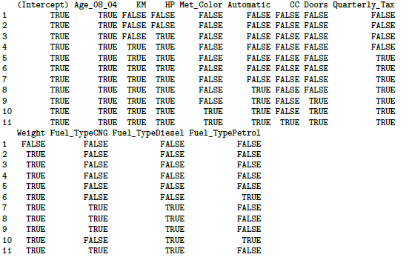
Exhaustive output shows best model for each number of predictors
This example exhaustive search was performed on original, untreated data.
Note: there are 12 instead of 10 predictors because with leaps we explicitly create dummy variables as part of the dataframe, this is handled internally by lm.

Slide 131
Adjusted R² for the models with 1 predictor, 2 predictors, 3 predictors, etc. (exhaustive search method)
> sum$adjr2
[1] 0.7556359 0.7922356 0.8267935 0.8436895 0.8494282 0.8534911
[7] 0.8544782 0.8545430 0.8543943 0.8542602 0.8540382
Adjusted R² drops until you hit 7 predictors, then stabilizes, so choose model with 7 predictors, according to the adj R² criterion
This example exhaustive search was performed on original, untreated data.

